Slide 1


MULUNGUSHI UNIVERSITY
School of Engineering and Technology
ICS 441
Advanced Cybersecurity
and Ethical Hacking
Unit 1: Engagement Ethics, Law, Safety, Threat Modeling and Risk Register
Lecture 1 • Lecturer: Mr. M Bwalya
Core rule: no written authorisation, no testing.
ICS 441 • Advanced Cybersecurity and Ethical Hacking • Unit 1
1

Slide 2
Unit learning outcomes
By the end of this unit, students should be able to:
• Separate ethical hacking from cybercrime using authorization, scope and intent.
• Prepare a safe engagement plan with Rules of Engagement and written consent.
• Handle evidence and discovered data using privacy and OPSEC principles.
• Explain threat modeling and convert threats into safe security test cases.
• Create a simple risk register with likelihood, impact, mitigation, owner and status.
Professional security work is planned, legal, safe and documented.
ICS 441 • Advanced Cybersecurity and Ethical Hacking • Unit 1
2

Slide 3
Course mindset: red team thinking, blue team responsibility
Red-team thinking
Blue-team responsibility
• Ask how a weakness could be discovered.
• Validate risk only in authorised safe-lab conditions.
• Document what happened clearly and honestly.
• Think creatively, but never act outside the ROE.
• Prevent weaknesses through secure design and configuration.
• Detect suspicious behaviour using logs and analytics.
• Respond quickly and contain incidents.
• Recover and improve controls after lessons learned.
ICS 441 • Advanced Cybersecurity and Ethical Hacking • Unit 1
3

Slide 4
What makes this course advanced?
Beyond basic awareness
Professional capability
• Move from “what is malware?” to how attacks progress across systems.
• Connect identity, networks, endpoints, applications, data and cloud.
• Study both offensive testing and defensive detection.
• Treat security as risk management, not just tool use.
• Use frameworks such as MITRE ATT&CK, OWASP and NIST.
• Collect evidence through logs, scans and lab observations.
• Write findings for technical and non-technical audiences.
• Prioritise remediation using business impact.
ICS 441 • Advanced Cybersecurity and Ethical Hacking • Unit 1
4

Slide 5
The modern attack surface
Traditional surface
Modern surface
Teaching focus
• Networks, servers and endpoints.
• Open ports, weak patching and poor segmentation.
• User laptops, desktops and mobile devices.
• Cloud environments, web apps and APIs.
• Containers, CI/CD pipelines and supply chains.
• IoT, edge devices and third-party integrations.
• Understand where systems are exposed.
• Test only within approved lab scope.
• Map weaknesses to controls and evidence.
ICS 441 • Advanced Cybersecurity and Ethical Hacking • Unit 1
5

Slide 6
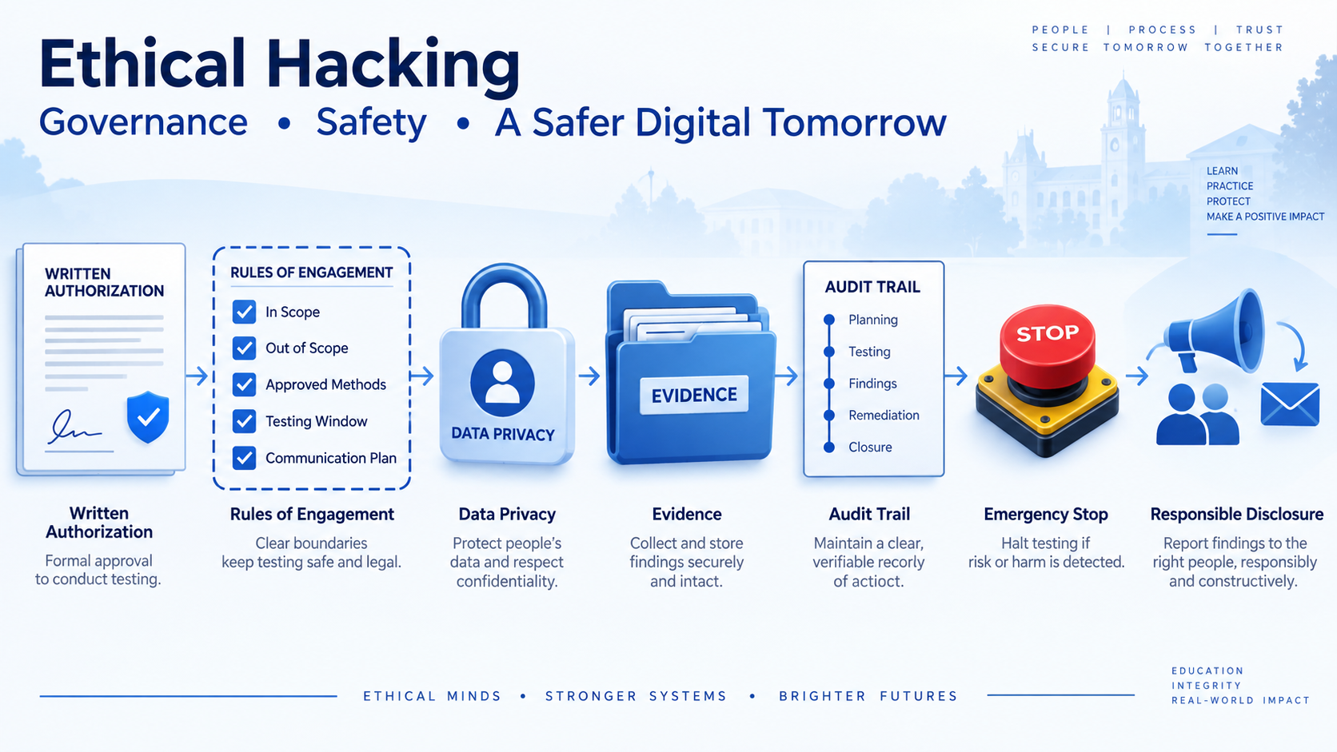
Ethical hacking in context
Visual summary: authorisation, ROE, privacy, evidence, audit trail and responsible disclosure.
ICS 441 • Advanced Cybersecurity and Ethical Hacking • Unit 1
6

Slide 7
Ethical hacking versus cybercrime
Ethical hacking
Cybercrime
• Legal and explicitly authorised by the system owner.
• Has written scope, approved methods and a defined time window.
• Intent is to improve security and reduce risk.
• Findings are documented and reported responsibly.
• No permission from the owner.
• May involve theft, disruption, data exposure or coercion.
• Intent is harmful, selfish or unlawful.
• Creates legal, disciplinary and reputational consequences.
ICS 441 • Advanced Cybersecurity and Ethical Hacking • Unit 1
7

Slide 8
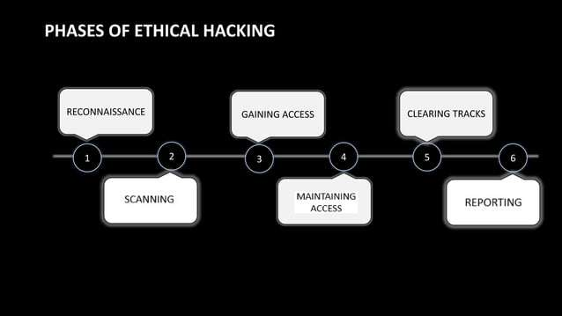
Phases of ethical hacking — interpreted safely
ICS 441 • Advanced Cybersecurity and Ethical Hacking • Unit 1
8

Slide 9
Safe ethical-hacking workflow
From permission to improvement
1
2
3
4
5
6
Authorize
Plan
Observe
Validate
Report
Retest
Written consent and signed scope.
ROE, timeline, contacts and limits.
Reconnaissance within permitted scope.
Test safely without unnecessary harm.
Evidence, impact and remediation.
Confirm fix and close findings.
Every step must remain authorised, scoped, logged and reversible.
ICS 441 • Advanced Cybersecurity and Ethical Hacking • Unit 1
9

Slide 10
Key frameworks we will use
MITRE ATTandCK
OWASP
NIST guidance
• Common language for adversary tactics and techniques.
• Useful for mapping tests to expected detections.
• Helps identify coverage gaps.
• Source for web application security testing.
• Supports learning on auth, sessions, APIs and secure coding.
• Provides practical checklists and testing guidance.
• Supports testing, incident handling and risk management.
• Useful for structured professional documentation.
• Connects technical findings to governance.
ICS 441 • Advanced Cybersecurity and Ethical Hacking • Unit 1
10

Slide 11
Defender response to offensive actions
Prevent
Detect
Respond and recover
• Secure configuration and hardening.
• Least privilege and MFA.
• Secure coding and patching.
• Logs, SIEM, IDS and analytics.
• Alert on suspicious activity.
• Measure visibility across systems.
• Triage and contain incidents.
• Restore services and preserve evidence.
• Document lessons learned.
ICS 441 • Advanced Cybersecurity and Ethical Hacking • Unit 1
11

Slide 12
Engagement ethics: why safety comes first
Important teaching points
• Technical skills are irrelevant without a legal and ethical framework.
• Authorization is the line between a security professional and a criminal.
• Testing must minimize disruption, privacy harm and data exposure.
• A professional tester can justify every action taken during the engagement.
• When risk is unclear, pause and escalate instead of improvising.
No permission. No scope. No testing.
ICS 441 • Advanced Cybersecurity and Ethical Hacking • Unit 1
12

Slide 13
Rules of Engagement (ROE): the safety contract
What ROE defines
Why ROE matters
• In-scope and out-of-scope assets.
• Allowed methods, tools, techniques and rate limits.
• Testing window, maintenance windows and stop conditions.
• Contacts, escalation paths and response service levels.
• Prevents accidental harm to production services.
• Protects students, staff and the institution.
• Makes testing auditable and defensible.
• Turns vague permission into operational boundaries.
ICS 441 • Advanced Cybersecurity and Ethical Hacking • Unit 1
13

Slide 14
Defining scope clearly
In-scope examples
Out-of-scope examples
• Named lab hosts, subnets, URLs and APIs.
• Dedicated test accounts and sample data.
• Approved cloud sandbox resources.
• Specific time window and controlled test methods.
• Production databases and personal email.
• DoS, destructive actions or social engineering unless approved.
• Third-party systems not owned by the client.
• Any asset not explicitly named in the ROE.
ICS 441 • Advanced Cybersecurity and Ethical Hacking • Unit 1
14

Slide 15
Written consent before testing
What consent must include
• Exact systems, accounts, URLs or networks approved for testing.
• Approved dates, times, techniques and emergency stop conditions.
• Contacts for escalation and rapid reporting of critical findings.
• Data-handling, non-disclosure and evidence storage rules.
• Signatures from the authorised owner or delegated authority.
Store consent with the test plan; update it when scope changes.
ICS 441 • Advanced Cybersecurity and Ethical Hacking • Unit 1
15

Slide 16
Responsible disclosure of vulnerabilities
Internal classroom process
Quality expectations
• Report promptly with clear reproduction steps.
• Include screenshots, timestamps and affected assets where needed.
• Propose severity and feasible mitigation.
• Coordinate retesting after the owner fixes the issue.
• Be factual, neutral and respectful.
• Avoid publishing details without approval.
• Do not include unnecessary exploit code.
• Focus on helping the owner reduce risk.
ICS 441 • Advanced Cybersecurity and Ethical Hacking • Unit 1
16

Slide 17
Operational Security (OPSEC) in the lab
Network and host hygiene
Credential safety
• Use isolated networks such as host-only or NAT.
• Create VM snapshots before risky activities.
• Label test machines clearly.
• Block unintended outbound traffic when required.
• Use dedicated test accounts.
• Never reuse personal or production credentials.
• Rotate passwords after exercises.
ICS 441 • Advanced Cybersecurity and Ethical Hacking • Unit 1
17

Slide 18
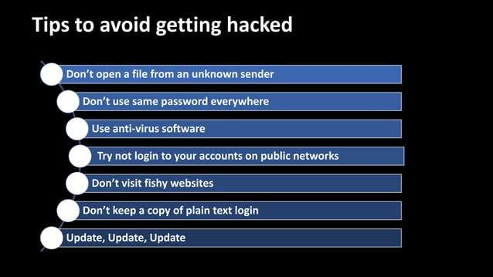
Cybersecurity hygiene reminders
Source visual from the attached lecture notes; use it as a classroom discussion prompt.
ICS 441 • Advanced Cybersecurity and Ethical Hacking • Unit 1
18

Slide 19
Secure handling and privacy of discovered data
Data minimisation
Evidence protection
• Collect only what is necessary to prove the finding.
• Avoid bulk downloads of sensitive data.
• Stop and escalate if unexpected personal data appears.
• Classify evidence by sensitivity.
• Redact names, IDs, passwords and tokens.
• Encrypt evidence at rest.
• Restrict access using least privilege.
ICS 441 • Advanced Cybersecurity and Ethical Hacking • Unit 1
19

Slide 20
Evidence management and audit trail
Good evidence practices
• Record timestamps, commands, hashes, source IPs and observed results.
• Use screenshots only when they add clarity and crop them safely.
• Caption screenshots so they match log lines or test steps.
• Store evidence in approved locations, not personal cloud-sync folders.
• Define retention and secure disposal rules in the engagement plan.
Evidence should be accurate, minimal, protected and traceable.
ICS 441 • Advanced Cybersecurity and Ethical Hacking • Unit 1
20

Slide 21
Chain of custody for sensitive evidence
Protecting trust in evidence
1
2
3
4
5
6
Collect
Label
Protect
Transfer
Review
Dispose
Capture minimum proof.
Asset, source and timestamp.
Encrypt and restrict access.
Record who received it.
Use for remediation.
Securely delete after sign-off.
Every step must remain authorised, scoped, logged and reversible.
ICS 441 • Advanced Cybersecurity and Ethical Hacking • Unit 1
21

Slide 22
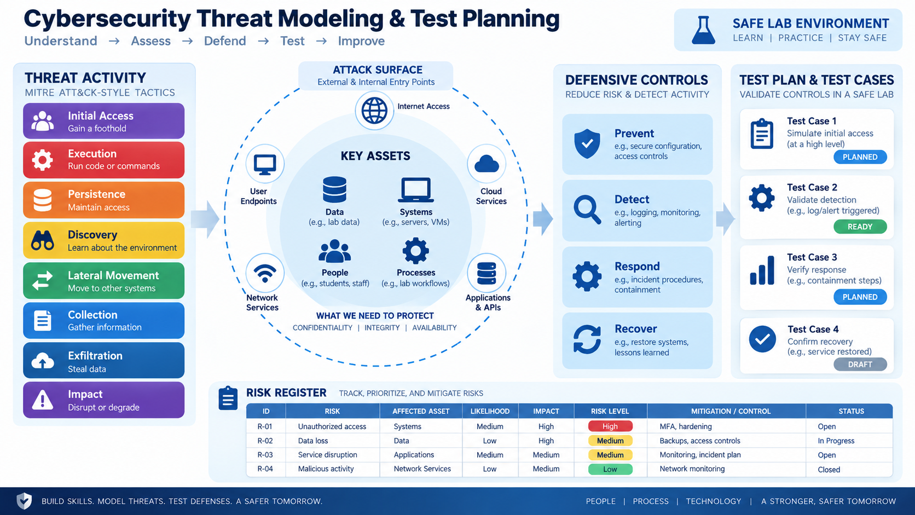
Threat modeling and test planning overview
Identify assets, model the attack surface, select controls, create tests and track risk.
ICS 441 • Advanced Cybersecurity and Ethical Hacking • Unit 1
22

Slide 23
Threat modeling: definition and purpose
What is threat modeling?
• A structured process for identifying, quantifying and addressing security risks.
• It asks “what can go wrong?” before attackers or failures prove it in production.
• It helps teams understand the system attack surface and prioritize security effort.
• It is proactive: design weaknesses are cheaper to fix before implementation.
• It turns security thinking into diagrams, hypotheses, tests and controls.
Threat modeling moves security left.
ICS 441 • Advanced Cybersecurity and Ethical Hacking • Unit 1
23

Slide 24
Benefits of threat modeling
For security teams
For project teams
• Finds design flaws early in the SDLC.
• Provides systematic coverage instead of random testing.
• Reduces the chance of missing critical threats.
• Generates meaningful security test cases.
• Improves communication among developers, architects and testers.
• Creates shared understanding of security requirements.
• Supports prioritization when time and budget are limited.
• Makes remediation easier to justify.
ICS 441 • Advanced Cybersecurity and Ethical Hacking • Unit 1
24

Slide 25
Threat modeling frameworks
STRIDE
PASTA and DREAD
OWASP Threat Modeling Guide
• Spoofing, Tampering, Repudiation.
• Information Disclosure, Denial of Service.
• Elevation of Privilege.
• PASTA is risk-centric and attack-simulation oriented.
• DREAD estimates damage, reproducibility, exploitability, affected users and discoverability.
• Practical guidance for application threat modeling.
• Useful for turning design diagrams into security questions.
ICS 441 • Advanced Cybersecurity and Ethical Hacking • Unit 1
25

Slide 26
Security test planning
What is a security test plan?
Common approaches
• A document or strategy that defines scope, objectives, resources, schedule and methods.
• It translates threat-model output into actionable test cases.
• It states what evidence will prove whether a control works.
• It defines safety controls before testing starts.
• SAST: analyze source code for vulnerabilities.
• DAST: test a running application for vulnerabilities.
• Penetration testing: simulate a controlled real-world attack.
• Review and retest: confirm remediation effectiveness.
ICS 441 • Advanced Cybersecurity and Ethical Hacking • Unit 1
26

Slide 27
The crucial link: threats become test cases
How threat modeling informs testing
• The primary threat-model output is a list of potential threats and attack vectors.
• Each threat should become a safe, scoped and repeatable test case.
• Each test case needs an objective, steps, expected evidence and success criteria.
• Tests should map to defensive controls such as logs, alerts and access policies.
• This makes assessment systematic rather than guesswork.
Model → Test → Evidence → Mitigation → Retest
ICS 441 • Advanced Cybersecurity and Ethical Hacking • Unit 1
27

Slide 28
Identifying key assets and crown jewels
Crown jewels
System inventory
• Sensitive data such as student, financial and health records.
• Critical services such as authentication, billing, payroll and registration.
• Brand reputation, intellectual property, API keys and source code.
• Business processes that must not fail.
• Web applications, APIs, endpoints and servers.
• Active Directory, cloud resources, VMs and databases.
• Third-party dependencies and integrations.
• Public repositories, auth providers and payment services.
ICS 441 • Advanced Cybersecurity and Ethical Hacking • Unit 1
28

Slide 29
Attack surface analysis
What is the attack surface?
Entry points and exposures
• All possible points where an attacker could enter, influence or extract data.
• Network interfaces, open ports and exposed services.
• Web applications, APIs, mobile apps and user endpoints.
• Cloud storage, human factors and third-party systems.
• Login and password reset forms.
• File upload, admin panels and public buckets.
• Default credentials and directory listing.
• Misconfigured services and unnecessary open ports.
ICS 441 • Advanced Cybersecurity and Ethical Hacking • Unit 1
29

Slide 30
Using MITRE ATTandCK in test planning
Core idea
How students use it
• Tactics describe attacker goals such as initial access or exfiltration.
• Techniques describe how attackers achieve those goals.
• ATTandCK gives red and blue teams a shared language.
• Tag each hypothesis with a tactic or technique.
• List expected HTTP, authentication, database or cloud logs.
• Identify detection gaps and control weaknesses.
• Prioritize tests tied to weak or missing detections.
ICS 441 • Advanced Cybersecurity and Ethical Hacking • Unit 1
30

Slide 31
Threat hypotheses and safe test cases
Threat hypothesis format
Test case format
• State how an attacker might compromise a system.
• Name the affected asset and likely attack path.
• Example: weak IAM policies may expose sensitive cloud storage.
• Connect the hypothesis to business impact.
• Objective: what exactly is being tested?
• Steps: safe, scoped, repeatable actions.
• Success criteria: what result proves the issue?
• Outcome: evidence and recommendation recorded.
ICS 441 • Advanced Cybersecurity and Ethical Hacking • Unit 1
31

Slide 32
Creating a Basic Risk Register
• Purpose: To document, prioritize, and track security risks.
Key Components:
  Risk Description: What is the vulnerability or threat?
  Likelihood: How probable is it that this will be exploited? (e.g., Low, Medium, High)
  Impact: What would be the business effect if exploited? (e.g., Financial loss, reputational damage)
  Risk Score: Likelihood × Impact (used for prioritization).
  Mitigation Steps: Recommended actions to reduce risk.
  Owner: Who is responsible for addressing this?
ICS 441 • Advanced Cybersecurity and Ethical Hacking • Unit 1
31

Slide 33
Basic risk register: example format
ID
Risk / Hypothesis
Asset
Likelihood
Impact
Mitigation / Control
Status
R-01
Weak MFA on admin accounts
Identity
High
High
Enforce MFA, review roles
Open
R-02
Public file upload exposure
Web app
Medium
High
Restrict file types, scan uploads
In progress
R-03
Default service banner leaks info
API
Medium
Medium
Harden headers and minimize banners
Open
R-04
Unencrypted evidence storage
Evidence
Low
High
Encrypt evidence folder and restrict access
Mitigated
R-05
Unpatched lab VM image
Endpoint
Medium
Medium
Patch template and retest
Open
Risk register = track, prioritize, assign ownership, mitigate and retest.
ICS 441 • Advanced Cybersecurity and Ethical Hacking • Unit 1
32

Slide 34
Mini-case discussion: safe lab incident
Scenario and discussion questions
• A student accidentally scans outside the approved lab subnet.
• Monitoring alarms trigger and the network team asks what happened.
• Which ROE controls should have prevented the mistake?
• What should the student do immediately?
• What evidence should be preserved and who should be informed?
Safety failures are process failures; improve the process, not only the person.
ICS 441 • Advanced Cybersecurity and Ethical Hacking • Unit 1
38

Slide 35
Quick knowledge check
Answer in pairs
• What is the difference between ethical hacking and cybercrime?
• Name four items that should appear in a Rules of Engagement document.
• Why is data minimization important during security testing?
• How does a threat hypothesis become a test case?
• What columns belong in a basic risk register?
• Why must evidence be protected and traceable?
Use examples, not memorized definitions only.
ICS 441 • Advanced Cybersecurity and Ethical Hacking • Unit 1
39

Slide 36
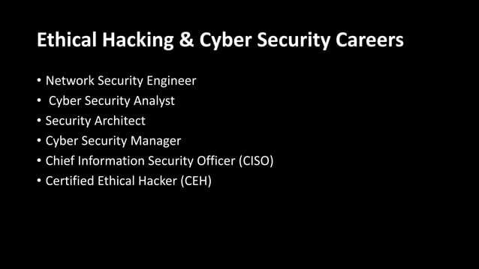
Careers linked to this unit
ICS 441 • Advanced Cybersecurity and Ethical Hacking • Unit 1
41

Slide 37
Key takeaways
Remember these points
• Ethical hacking is authorized, scoped, documented and risk-reducing.
• Rules of Engagement protect the tester, owner, institution and users.
• Threat modeling asks what can go wrong before it happens.
• A test plan converts threat hypotheses into safe, repeatable validation.
• A risk register tracks risk, likelihood, impact, mitigation, owner and status.
Skill + ethics + evidence + judgment.
ICS 441 • Advanced Cybersecurity and Ethical Hacking • Unit 1
42

Slide 38
Questions and next preparation
The aim is not to create reckless hackers. The aim is to develop security professionals who can analyze systems, understand risk, test safely and strengthen organizations.
Before the next class
THANK YOU
ICS 441 • Advanced Cybersecurity and Ethical Hacking • Unit 1
43

